Slide 1
Introduction to Signal
Asim Irfan 18CS38
Atif Nawaz 18CS56
Ayaz Lakho 18CS75

Slide 2
Content
Signal
Analog Signal
Digital Signal
Signal Processing
Classifications.

Slide 3
Signal
A signal is a function that conveys information about a phenomenon.
A signal are also used to carry information from one device to another device.
In electronics and telecommunications, it refers to any time varying voltage, current or electromagnetic wave that carries information.

Slide 4
Analog Signal
If a continuous-time signal x(t) can take on any value in the continuous interval (-∞+∞), then the continuous-time signal x(t) is called an analog signal.
An analog signal is a continuous signal in which one time-varying quantity (such as voltage, pressure, etc.) represents another time-based variable. In other words, one variable is an analog of the other.
Example:
Audio recording and reproduction.
Live sound.

Slide 5
Digital Signal
: A signal x[n] can take on only a finite number of distinct values, then we call this signal a digital signal.
Digital signal. A digital signal is a signal that is being used to represent data as a sequence of discrete values; at any given time it can only take on one of a finite number of values.
Examples: These are commonly refered as square waves or clock signals.

Slide 6
Signal Processing
Modifying a Signal,
Manipulating a Signal,
Transforming Signal is known as Signal processing.
Notes:
We will study only time shifting and convolution property here.

Slide 7
Classification of Signal
Here we will Explain some classification of signal.
Continuous Time and Discrete Time Signals
Even and Odd Signals
Right-Handed and Left-Handed-Signals
Periodic/Aperiodic

Slide 8
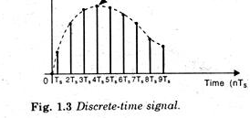
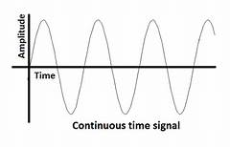
Continuous Time and Discrete Time Signals
A signal is said to be continuous when it is defined for all instants of time.
• A signal is said to be discrete when it is defined at only discrete instants of time.

Slide 9
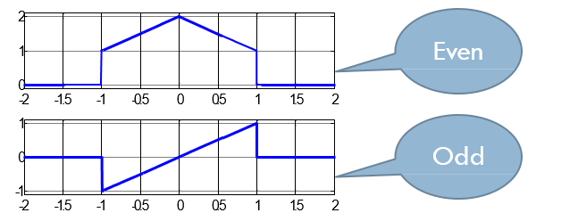
Even and Odd Signals
A signal is said to be even when it satisfies the condition x(t) = x(-t).
• A signal is said to be odd when it satisfies the condition x(t) = -x(-t) .

Slide 10
Right handed and Left handed Signal
• A right-handed signal and left-handed signal are those signals whose value is zero between a given variable and positive or negative infinity.
• A Right-handed signal is defined as any signal where f(t) = 0 for t < t1< ∞ • A Left-handed signal is defined as any signal where f(t) = 0 for t > t1> -∞

Slide 11
Periodic and Aperiodic
• Periodic signals repeat within a given time period.
• Mathematically represented by the equation: s(t) = s(t + T) where T is the period (1/frequency).
• Periodic signals exist in both AC (analog) and DC (digital) systems, like the sine wave or digital system clock signal.
• Aperiodic signals do not repeat.

Slide 12
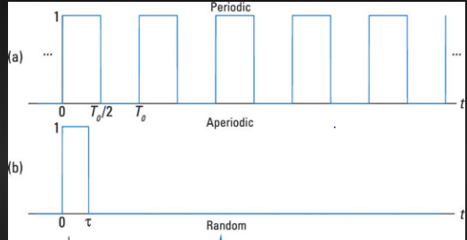

Slide 13
Thank you.

